Slide 1
TangoTab App v1.7 Requirements
24-September-12

Slide 2
Update History
v0.4 #1: updated wording for FB/Twitter Shares and added FB title vs. FB body #1: clarified that sharing should occur when an offer is claimed (not redeemed) #1: added “?” to sharing with description of message to show #1: clarified that login should occur before asking user to link sharing #2: remove “dismiss” button #3: changed wording to be consistent with web-page #3: added instructions on what to do if they cancel #3: removed additional confirmation step when at restaurant #3.a: added clarification of field states in the database #5: added user email address to “Contact Support” email #6: fixed arrow from “confirm”, not “cancel” #6: clarified to ask user only if setting is not active #7: updated to match web (two options) #7: updated to 25 miles (not 50 miles) #9: Removed “auto redeemed” button and replaced with “redeemed” #10: clarified to show “redeemed” or “expired”, but not “redeemed/expired” #12: added note that “date” button should be visible from “Search” too #13: new – added auto-signin after sign-up #14: new – added “refresh” pull-down #15: new – add better handling of server errors
#16: new – add requirement on miles vs. kilometers #17: new – auto-scroll down to next 10 offers
v0.5 #18: Zip/Postal Code Validation
#19: New Splash Screen #20: Passbook
#21: Consolidation of UI
#22: Push notification support
#23: check-in restricted
#24: Search offers before sign-in/up
#25: User Sign-up from within app (given #24)
#26: New sign-in graphics
#27: Show “Loading offers” instead of blank blip
#28: iPad version
#29: Move Ts and Cs down
#30: Asynchronous auto-checkin

Slide 3
Notes on Art
Please note that the artwork shown in the following pages is for illustration
Some items, like buttons (“Back”, date, etc.), spinning wheel, etc. are not meant to be copied exactly.
Please use standard iPhone artwork when possible, and match existing buttons and colors to the existing app
We will provide updates to some of the artwork

Slide 4
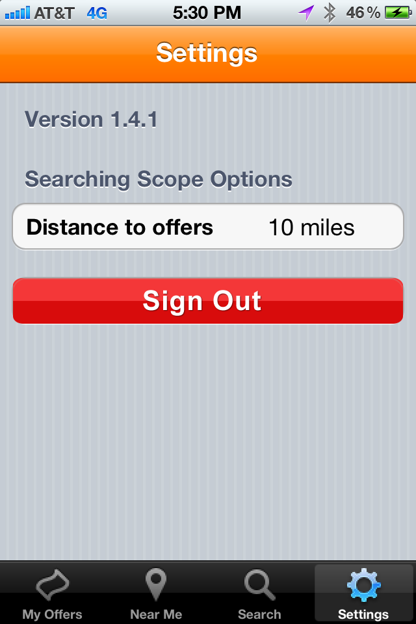
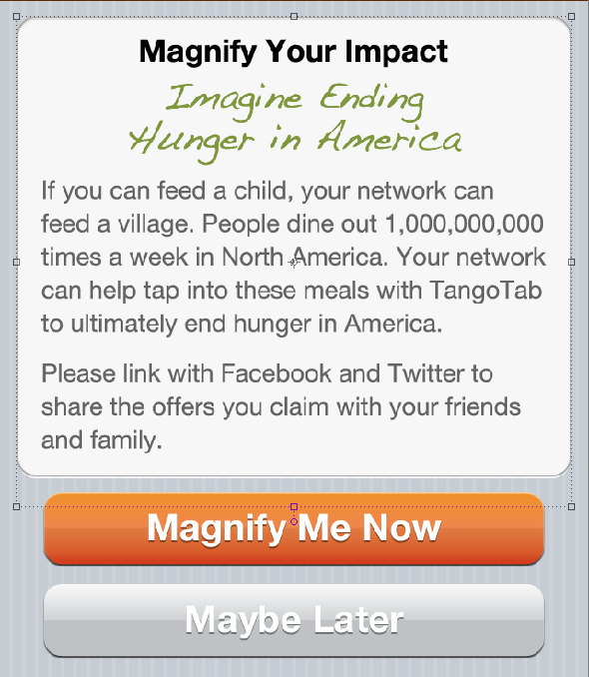
#1 Automated Sharing
Enlisting Evangelists
Search Preferences
Display
After
Upgrade
Or 3 claims
Search Radius 10mi
Magnify Impact in Fighting Hunger
FaceBook Share
Twitter Share
Link to
Facebook and then Twitter
Display alert to request user to link FB/Twitter in the following cases:
For an app upgrade: after login or when app opens (if already logged in)
For a new user: after 3rd claim
Share automatically when an offer is claimed (using the same messaging currently in the Facebook App)

Slide 5
#2 Upgrade Notification
Version x.y:
Improvement A
Etc.
Version x.y:
Improvement A
Etc.
Update Available
Version Updated
Update Now
Remind Me Later
Dismiss
Store version history in database accessible via web: version number followed by update notes
@ app start, check:
1) If version is older than available version, show update is available
If user selects: “Remind Me Later”, then open a reminder after 5 more opens
2) If version changed versus prior version, show “Version Updated”:
Show notes for all version changes since the prior version

Slide 6
#3 Cancel Offer
Or “Today” if the date of the offer is the same day as the day claim is being made.
Redeem
Back
Please remember this is only valid Monday, June 4th from 03:00pm to 07:00pm.
When you redeem at the restaurant, TangoTab feeds a person in need.
Restaurant Name
Thank You
Picture
Offer Details
Offer Date, Confirmation Code
Confirm
Redeem – I’m at the restaurant
Oops – Cancel Offer
Cancel Offer – I can’t go
Allow user to “cancel” claims – display an alert after they “claim” an offer
In "My Offers", within each offer:
Add a "Cancel Offer – I can’t go" button
Save to database “cancelled” occurred and email admin@TT
Rename: “Check In” to “Redeem – I’m at the restaurant”
Save to database “manual checkin” occurred and email deal manager @ admin@TT

Slide 7
#4 Spinning “Loading” Wheel
There is an extended delay in reaching our servers. This could be a network problem.
Error
Searching…
Keep Waiting
Contact Support
Use during delays: logging in, searching offers, etc.
Connecting (when logging in)
Searching (when searching offers)
Time-out after 10 seconds and display error
If they “contact support”, open an email:
To: support@tangotab.com
Subject: “iPhone App Network Delay”

Slide 8
#5 Contact Support
Version x.y.z
You cannot redeem this offer. It has already expired or is not valid yet.
Preferences
TangoTab
Search Radius 10mi
Auto Add to Calendar Yes/No
Magnify Impact in Fighting Hunger
Link FaceBook
Link Twitter
Personalize Message
OK
Contact Support
Contact Support
Sign out
Add ability for customer to contact support within the app
If initiated, open an email:
To: support@tangotab.com
Subject: “iPhone App Support – version x.y.z”
Message:
<… empty line …>
--------------------
Information for support:
Location: <gps coordinates”
Search Radius Setting: <search radius>
User ID: <email address>

Slide 9
#6 Add to Calendar
Please remember this is only valid on Monday, June 4th from 03:00pm to 07:00pm.
TangoTab feeds someone in need when you redeem the offer at the restaurant.
Would you like us to add this to your calendar automatically?
If you say yes, you can always turn this off in the settings.
Version x.y.z
Thank You
Add To Calendar?
Preferences
Search Radius 10mi
Add to Calendar Yes/No
Magnify Impact in Fighting Hunger
Link FaceBook
Link Twitter
Personalize Message
Confirm
Yes – Add to calendar
Oops – Cancel Offer
No Thanks
Contact Support
Sign out
The first time the user claims an offer, if “Add to Calendar” is “No”, ask if they want to turn it on
If they say “No Thanks”, do not ask again
If they say “Yes”
Turn “Add to Calendar” setting to “Yes”
For this event AND all future events while “Add to Calendar” = Yes, Open: “Add Event” after a claim and Pre-populate with:
Title: TangoTab at <Restaurant_Name>
Location: <Restaurant_Address>
Time/Date: Match deal time duration
Contents:
Your confirmation code is: xxxx
<Offer>
<Offer_URL>

Slide 10
#7 Not Near TangoTab City
Zip is <25miles away
Zip is >25miles away
TangoTab
TangoTab
Cities
Back
We’re Coming Soon
Dallas
Fort Worth
Oklahoma City
Chicago
Los Angeles
New York City
Hoboken
Toronto
Welcome to TangoTab
We’re not in your city yet. The closest TangoTab city is:
We will let you know when we come to your city.
You have offers nearby in:
Find your favorite restaurants and come back often as we add more restaurants.
When you eat, they eat
<city> x mi.
<city> x mi.
See Our Current Cities
Show these dialogs when a user signs up (after auto-login of req. #13)
<City> = nearest offer city (if <25 miles from zip) or nearest preferred city (if >25 miles from zip)
If user clicks: “Browse Our Cities”, show the “Cities” window and allow user to click on the cities to bring up the “offers” for that city (from the search window)

Slide 11
#8 Change Default Mile Radius
Please change the default mile radius to “20 miles”

Slide 12
#9 Redeemed/Expired Offers
Redeem
Redeem
Back
Back
Restaurant Name
Restaurant Name
Picture
Offer Details
Picture
Offer Details
Offer Date, Confirmation Code
Offer Date, Confirmation Code
Redeem – I’m at the restaurant
Cancel Offer – I can’t go
Redeemed
Expired
If an offer is redeemed or expired, remove “Redeem – I’m at the restaurant” and change “Cancel Offer – I can’t go” to:
Redeemed
Expired

Slide 13
#10 Gray-Out Expired Offers
My Offers
Restaurant Name
Picture
Restaurant
Confirmation Code:…
Etc.
Restaurant Name
Picture
Restaurant
Redeemed
Etc.
Restaurant Name
Picture
Restaurant
Expired
“Gray-Out” expired offers
Change “Confirmation code” to “Redeemed” or “Expired”
Allow the user to “tap” into the offer to see the details

Slide 14
#11 Removed “Claimed Offers”
After a user “claims” an offer, remove it from the offers shown in the “Search” or “Near Me” Windows
In other words, once an offer has been claimed, we no longer need to show it to the user

Slide 15
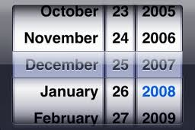
#12 Add “Date” option
Add a method for users to choose the date to search for offers
NOTE: This needs to be comprehended in the new “filtering” scheme referenced in requirement #21
e.g. “Today”
or 3-character month abbreviation (Jan,Feb,Mar,Apr,May,Jun,Jul,Aug,Sep,Oct,Nov,Dec) followed by day
Near Me
Select Date
Search
Dec 25
Map
Save
Dec 25

Slide 16
#13 – Auto sign-in after sign-up
If a user signs up via the email, automatically sign them in (do not request them to log in and re-input their password)

Slide 17

#14 – “Refresh”
If user “pulls down” on list in “near me”, then refresh: http://www.iphonehacks.com/2012/03/native-apps-pull-to-refresh-feature.html
Near Me
Dec 25
Map
Show if user “pulls down”

Slide 18
#15 – Server Communication Problem
Better handling of back-end communication problems:
Time-out after 10 seconds
Flurry Event named “Time-out”
Show Alert Title: “Network Time-out”
Body: See below
Button “Dismiss”: Reset the time-out and continue waiting for a response
Button “Contact Support”
Empty response:
Flurry Event named “Empty back-end response”
Show Alert Title: “System Error”
Body: See below
Button “Dismiss”
Button “Contact Support”
Other alert details:
Body: “We apologize for the inconvenience, but we are having technical difficulties in reaching our servers. If you receive this frequently, please contact support.”

Slide 19
#16 – Miles vs. Kilometers
If user registers in Canada, show settings “distance” in km instead of “miles”
Determine which to show based on the user registration information (Canada zip-code vs. US zip-code)

Slide 20
#17 – Auto scroll down offers
When the user scrolls to the bottom of the page, automatically load the next 10 offers (rather than ask them to push a button)
In other words, when the user hits the bottom of the screen, have the app automatically perform the function that would have occurred if the user had pushed the button to show the next 10 offers

Slide 21
#18 – Zip/Postal Code Validation
We need to add zip/postal code validation to the mobile apps.

Slide 22

#19 – New Splash Screen
We want to replace the splash screen on both apps to reflect our new logo and fresher branding

Slide 23
#20 - Passbook Integration
Allow the option for users to upload claimed offers to Passbook
The offers should support geo-location, such that the offer creates a notification when they arrive at the restaurant

Slide 24
#21 - Consolidation and Simplification of UI
Remove bar from bottom of screen
Move settings icon to be in the title bar
Add mechanism to display a set of filters:
Date
Meal (breakfast, lunch, drinks, dinner)
Cuisine Type (Fine, Fast, Food, Drink)
Features in current “Search” bar (restaurant name, city/state/zip)
Need intuitive way to add “My Offers”

Slide 25
#22 - Push Notifications
Add support to send push notifications to the device
Also need to setup a push notifications server
Push notification server will need a method to be accessed from our email system (Silverpop)

Slide 26
#23 - Check-In Restriction
Check-ins should occur automatically
As a back-up users can check-in manually (this capability is already present)
We want to restrict this only be allowed in the time window:
15 min before the offer period starts
2 hours after the claim period ends (this is to allow sufficient time for a customer to finish their meal and pay)
This will require coordination with our team responsible for web-services (which currently does the validity check)
If the offer is before the valid time period, please display:
The offer is not valid yet
If the offer is after, please tie into the v1.5 functionality that asks if they attended an offer instead:
i.e. “We hope you enjoyed your visit to…” “Were you able to attend?”

Slide 27
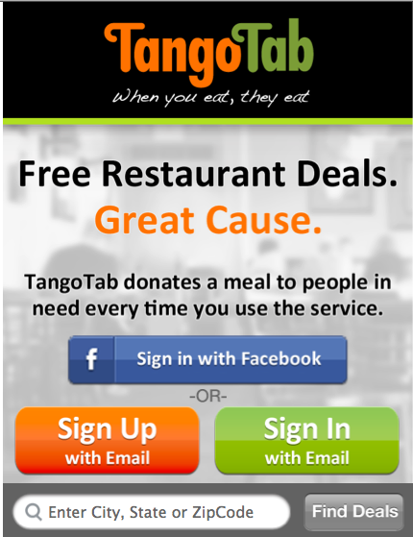
#24 - View offers before sign-up
Support bottom bar if not already done in v1.6 (it was optional)
If user pushes “find deals” without any input, then please search near the current location (e.g. “Near Me” functionality)
Otherwise, please use input criteria

Slide 28
#25 – User sign-in/sign-up
Since the app can now be used before sign-in/sign-up, please add the ability for the user to sign-up in the new UI
If they do not do this before trying to view “my offers” or “claim” a new offer, then direct them to the sign-in/sign-up screen automatically

Slide 29
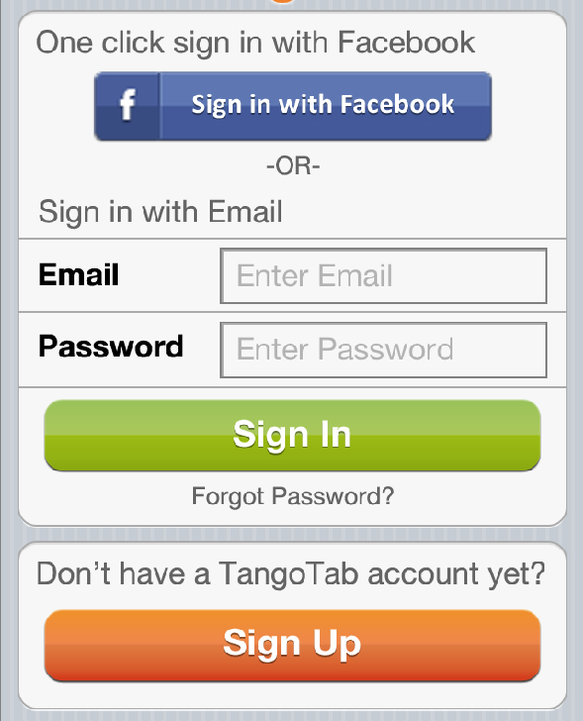
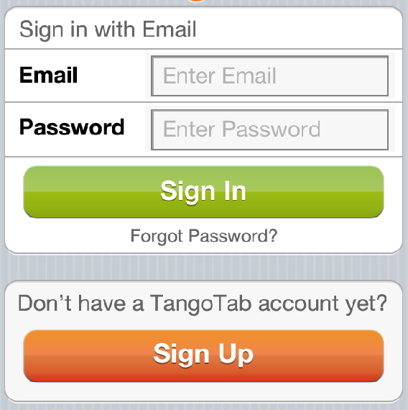
#26 - New Sign-in Screens
If they search offers, then sign-in
If they click “email sign-in” from first screen

Slide 30
#27 – Show “Loading Offers” instead of flashing a blank screen while offers are loading
If the user changes the zip-code radius and then goes to “Near Me”, the app currently flashes a blank screen while loading, which looks very awkward
Please change to show “Loading Offers” instead.

Slide 31
#28 – please create an iPad version

Slide 32
#29 – Move Ts & Cs to bottom of offer
Goal is to show enter Ts & Cs if desired, but not obscure the action oriented buttons.
Thus, the user can scroll if they want to see them all, but it won’t hurt the user experience.

Slide 33
#30 – Auto-checkin async to user interface
Currently, if there is a delay on web-services or the internet is slow, the system can time out while trying to auto-checkin and eventually show an error
Change this to:
Do the auto-checkin in the background
Immediately show the confirmation to the user (instead of waiting for the server)
If the auto-checkin fails, queue it up in the app to try again later

